Slide 1

EMERGEncy ID NET “CRASHED” project
(Cause of RASHes in the ED)
PROJECT TRAINING – ALL SITES
May 26, 2023 @ 10-11:30am PT

Slide 2
Training Agenda
Welcome/Introductions
Background and Eligibility
Data collection
Image capture and specimen collection
REDCap
Screening and Enrollment
Audit
Site team communication

Slide 3
Core Project Team
UCLA (Primary site and Data Coordinating Center) | OV-UCLA (Clinical Coordinating Center) | Cedars-Sinai MC | CDC Mpox Response
David Talan, MD – Co-PI Bill Mower, MD – Statistician, Site PI Jesus Torres, MD, MPH – Co-I, Site PI* Lorenzo Duvergne – REDCap manager* Omai Garner, PhD – Lab Director* | Gregory Moran, MD – Co-I, Site PI Anusha Krishnadasan, PhD – PD* Kavitha Pathmarajah, MPH – PM* Matthew Waxman, MD – Co-I | Carl Berdahl, MD – Co-PI, Site PI* | Amy Pullman, MPH, MT Nicole Fehrenbach, MPP Scott Santibañez MD, MPHTM Elizabeth Haller, MEd

Slide 4

CRASHED
Project Sites
Site Initials | Site name | IRB determination | Subcontract
BSMP | Baystate Medical Center
CSMP | Cedars-Sinai Medical Center
OVMP | Olive View-UCLA Medical Center |  | N/A
HCMP | Hennepin County Medical Center
JHMP | Johns Hopkins Hospital
TUMP | Temple University Hospital
OHMP | Oregon Health & Science University
RRMP | Ronald Reagan UCLA Medical Center |  | N/A
UIMP | University of Iowa
UMMP | University of Mississippi Medical Center
NMMP | University of New Mexico Hospital
MKMP | University of Missouri-Kansas City
VWMP | Valleywise Medical Center

Slide 5
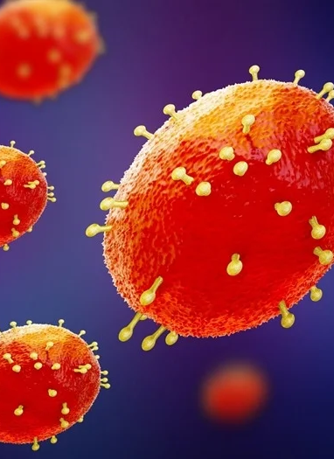
What is Mpox?
  In 2022, the world experienced an outbreak of a virus called Mpox (aka monkeypox), which is a virus from the class orthopoxviridae that has been circulating in Africa for decades
  As of 3/1/2023, the US has had 30,225 cases and 38 deaths (56,006 more cases worldwide)
  Most cases have been in gay, bisexual, & other men who have sex with men
  Mpox is not a sexually transmitted disease.
    It spreads through close contact, so it does often spread during contact with sexual partners

Slide 6
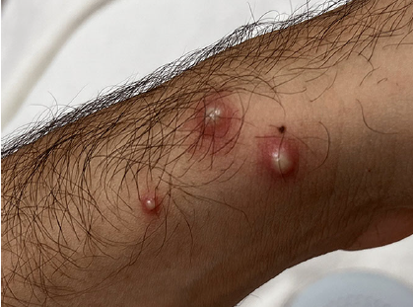
What are the symptoms of Mpox?
  According to the CDC, this is how Mpox “presents”:
    Contact with an infected person occurs
    3-17 day incubation period without any symptoms
    Rash starts on “hands, feet, chest, face, or mouth or near the genitals, including penis, testicles, labia, and vagina, and anus”
    Flu-like symptoms can occur: fever, chills, swollen lymph nodes, exhaustion, muscle aches, backache, headache, respiratory symptoms
    Some have flu-like symptoms before rash
    Some get a rash first then flu-like symptoms
    Some only get a rash

Slide 7
Why look in EDs for Mpox now?
Healthcare providers think the Mpox outbreak is over, but Mpox hasn’t completely gone away
There have been reports of “breakthrough” infections
Since many at-risk people are vaccinated, we may start seeing more cases in populations that were not initially thought to be at-risk

Slide 8
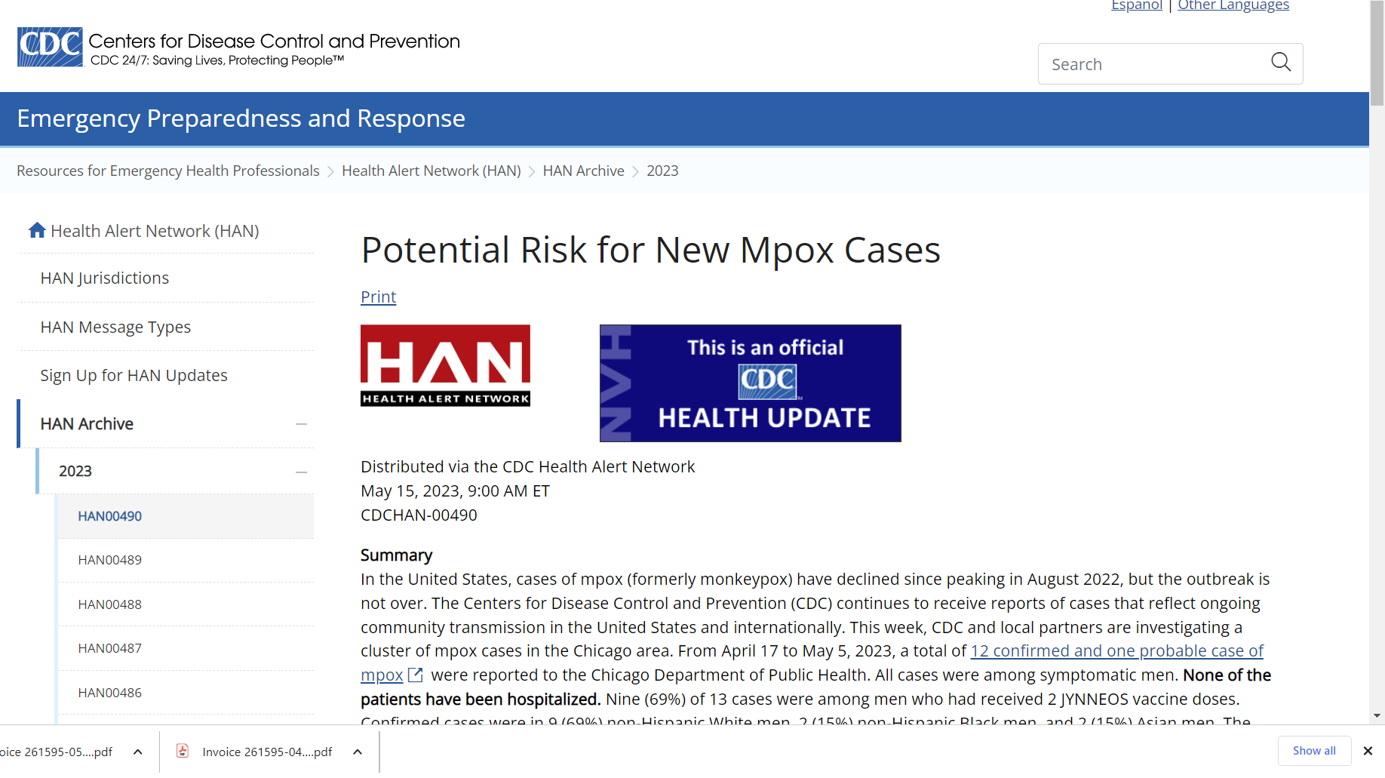
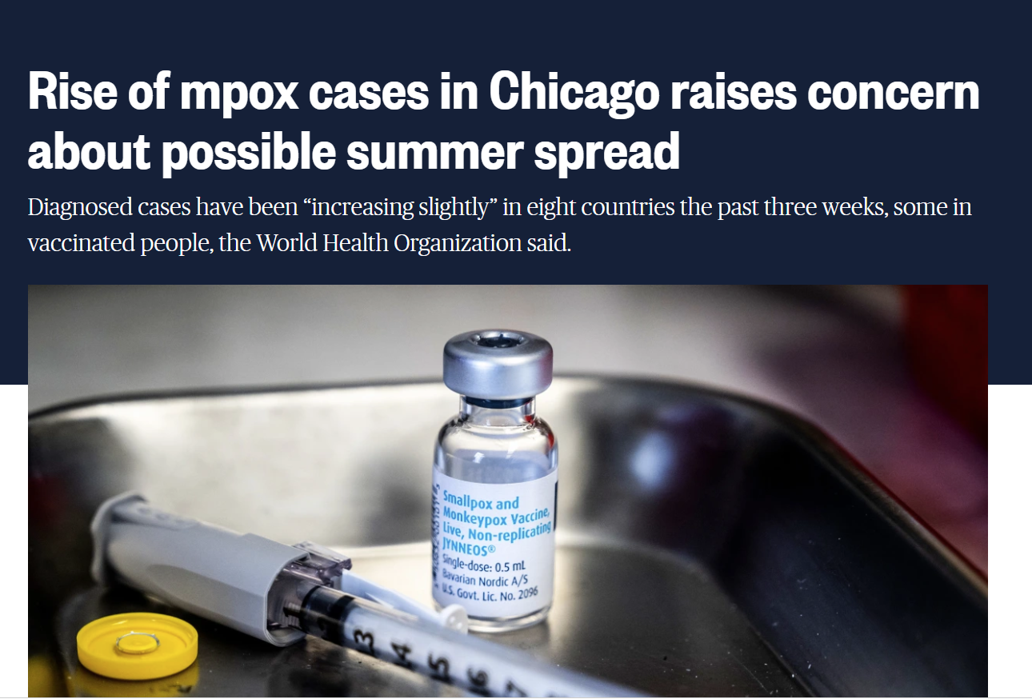
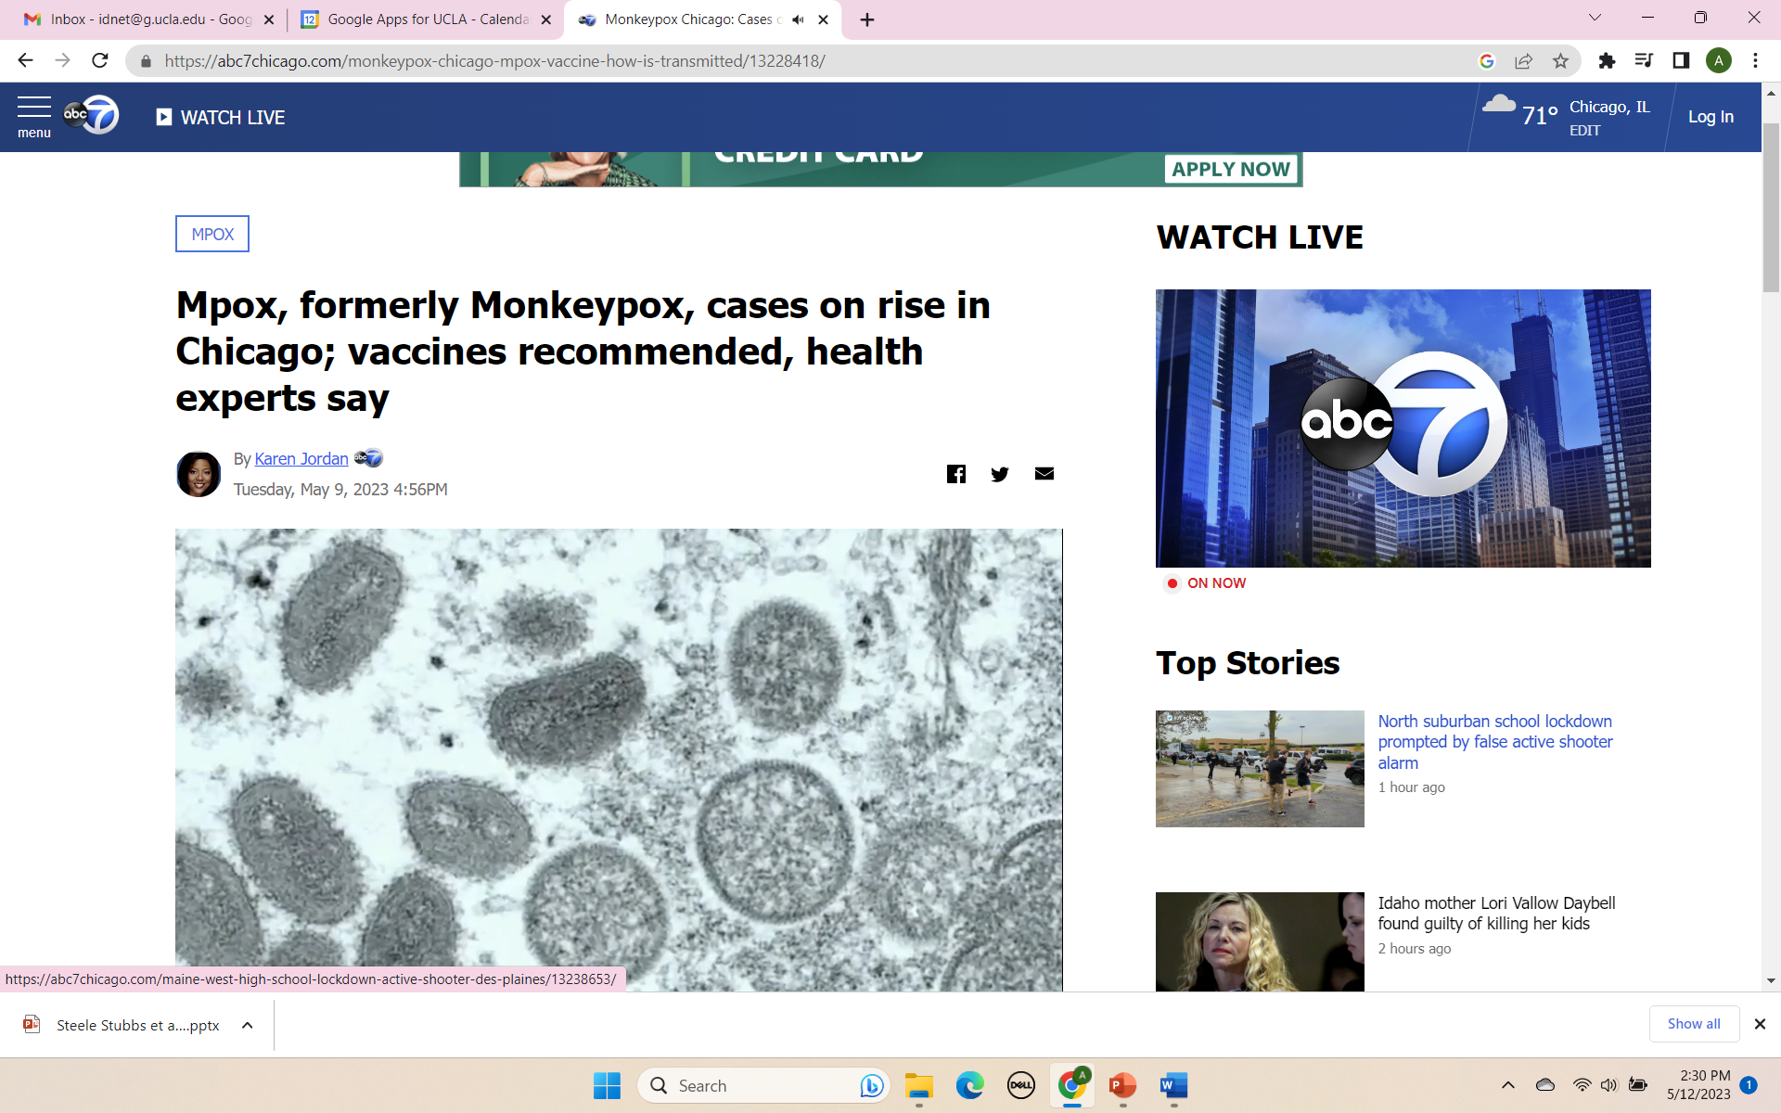
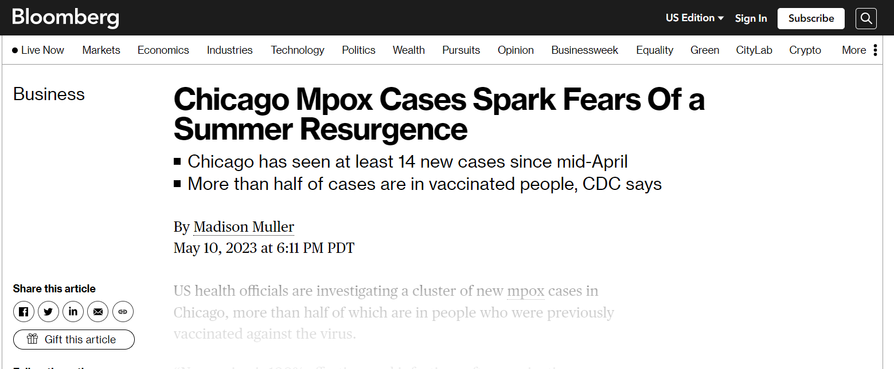

Slide 9
Project Design and objectives
Design - Multi-center prospective surveillance project
13 EMERGEncy ID NET U.S. sites
Objectives:
    Determine the prevalence of Mpox among patients with any skin rash in the ED population,
    Describe presenting symptoms and signs,
    Characterize community risk factors and describe patients’ health outcomes.

Slide 10
Eligibility criteria
Inclusion criteria
ED patient ≥3 months old,
Exclusion Criteria
Prior enrollment ,
Records flagged “break the glass” or “opt out,
Does not speak English or Spanish,
Unable to consent
Has one or more skin lesions that appears pustular, vesicular, crusted or ulcerated

Slide 11
Eligible rashes: Pustular, vesicular (or bullous)

Slide 12
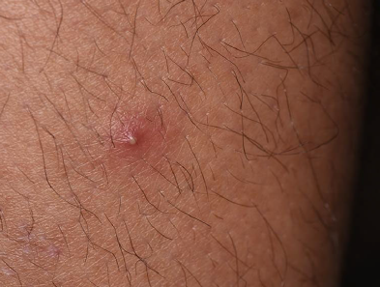
Eligible rashes: Pustular

Slide 13
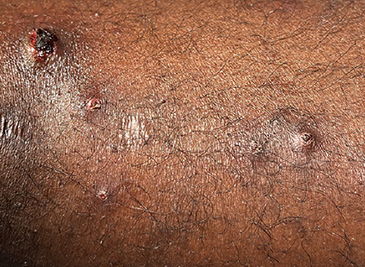
Eligible rashes: Crusted

Slide 14
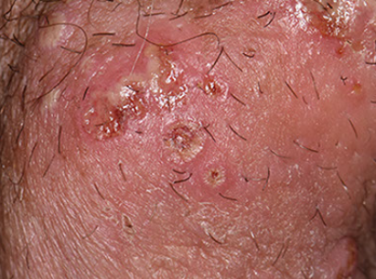
Eligible rashes: Erosive

Slide 15
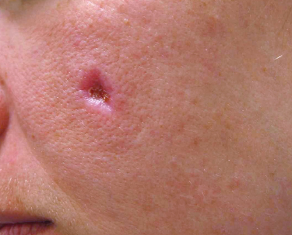
Eligible rashes: Ulcerated

Slide 16
Screening
Chief complaint of skin rash, lesion, skin ulcer, sexually transmitted infection, fever/chills, pain in genital or anal region
Review triage and nursing notes
Posters/flyers in ED doc room with Inclusion Criteria and site team contact info
“CALL US FOR RASH”- do not put “Mpox” on the flyer
Call/talk to treating clinician to confirm eligibility
Regular announcements
“DO-NUT forget”
Initially, go see patients with any rash if possible
Backscreen after non-coverage hours for missed eligible patients and note them on the screening log. If patient is admitted, can approach for enrollment!

Slide 17
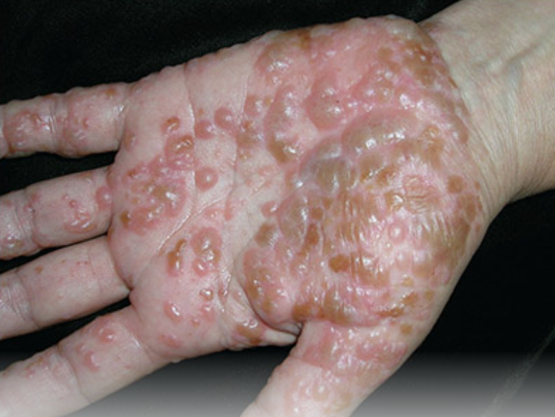
HELP DEM
RESEARCH
Contact x73115 for any rash!
Examples:
$10 Amazon Gift Card
ULCERATED
CRUSTED
ULCERATED
PUSTULAR
(or bullous)
EROSIVE
VESICULAR
PUSTULAR

Slide 18
Screening Log – anyone with a rash
Screening Log – IDNET Mpox surveillance – OV-UCLA
Screening ID | ED date | MRN | Last Name | First Name | Enrolled (Y/N) | Reason for not enrolling | Project ID
1 | 3/28/2023 | 123456 | Doe | Jane | N | Rash not pustular, vesicular | N/A
2 | 4/1/2023 | 567890 | Patrick | Saint | Y |  | OVMP001
3 | 4/2/2023 | 789909 | Bunny | Easter | N | Declined to participate | N/A
4 | 4/4/2023 | 234435 | Rabbit | Peter | N | Outside SC coverage hours | N/A
5 | 4/6/2023 | 234234 | Man | Bat | Y |  | OVMP002

Slide 19
Patient approach
Have all documents and materials ready (see MOP)
Ask treating clinician permission to approach
Prisoners and vulnerable patients - reach out to site PI/team for guidance
Be sensitive to the social and political stigma of Mpox among certain populations and cultures
Remind the participant they do not have to answer any questions they are not comfortable answering

Slide 20
Informed consent
Concise written informed consent
For ages 8-17, obtain assent from patient and informed consent from parent
For ages <8, obtain informed consent from parent
Give copy ICF to participant
Keep all consent and assent documents (and Participant Contact info form) in secure location at your site

Slide 21
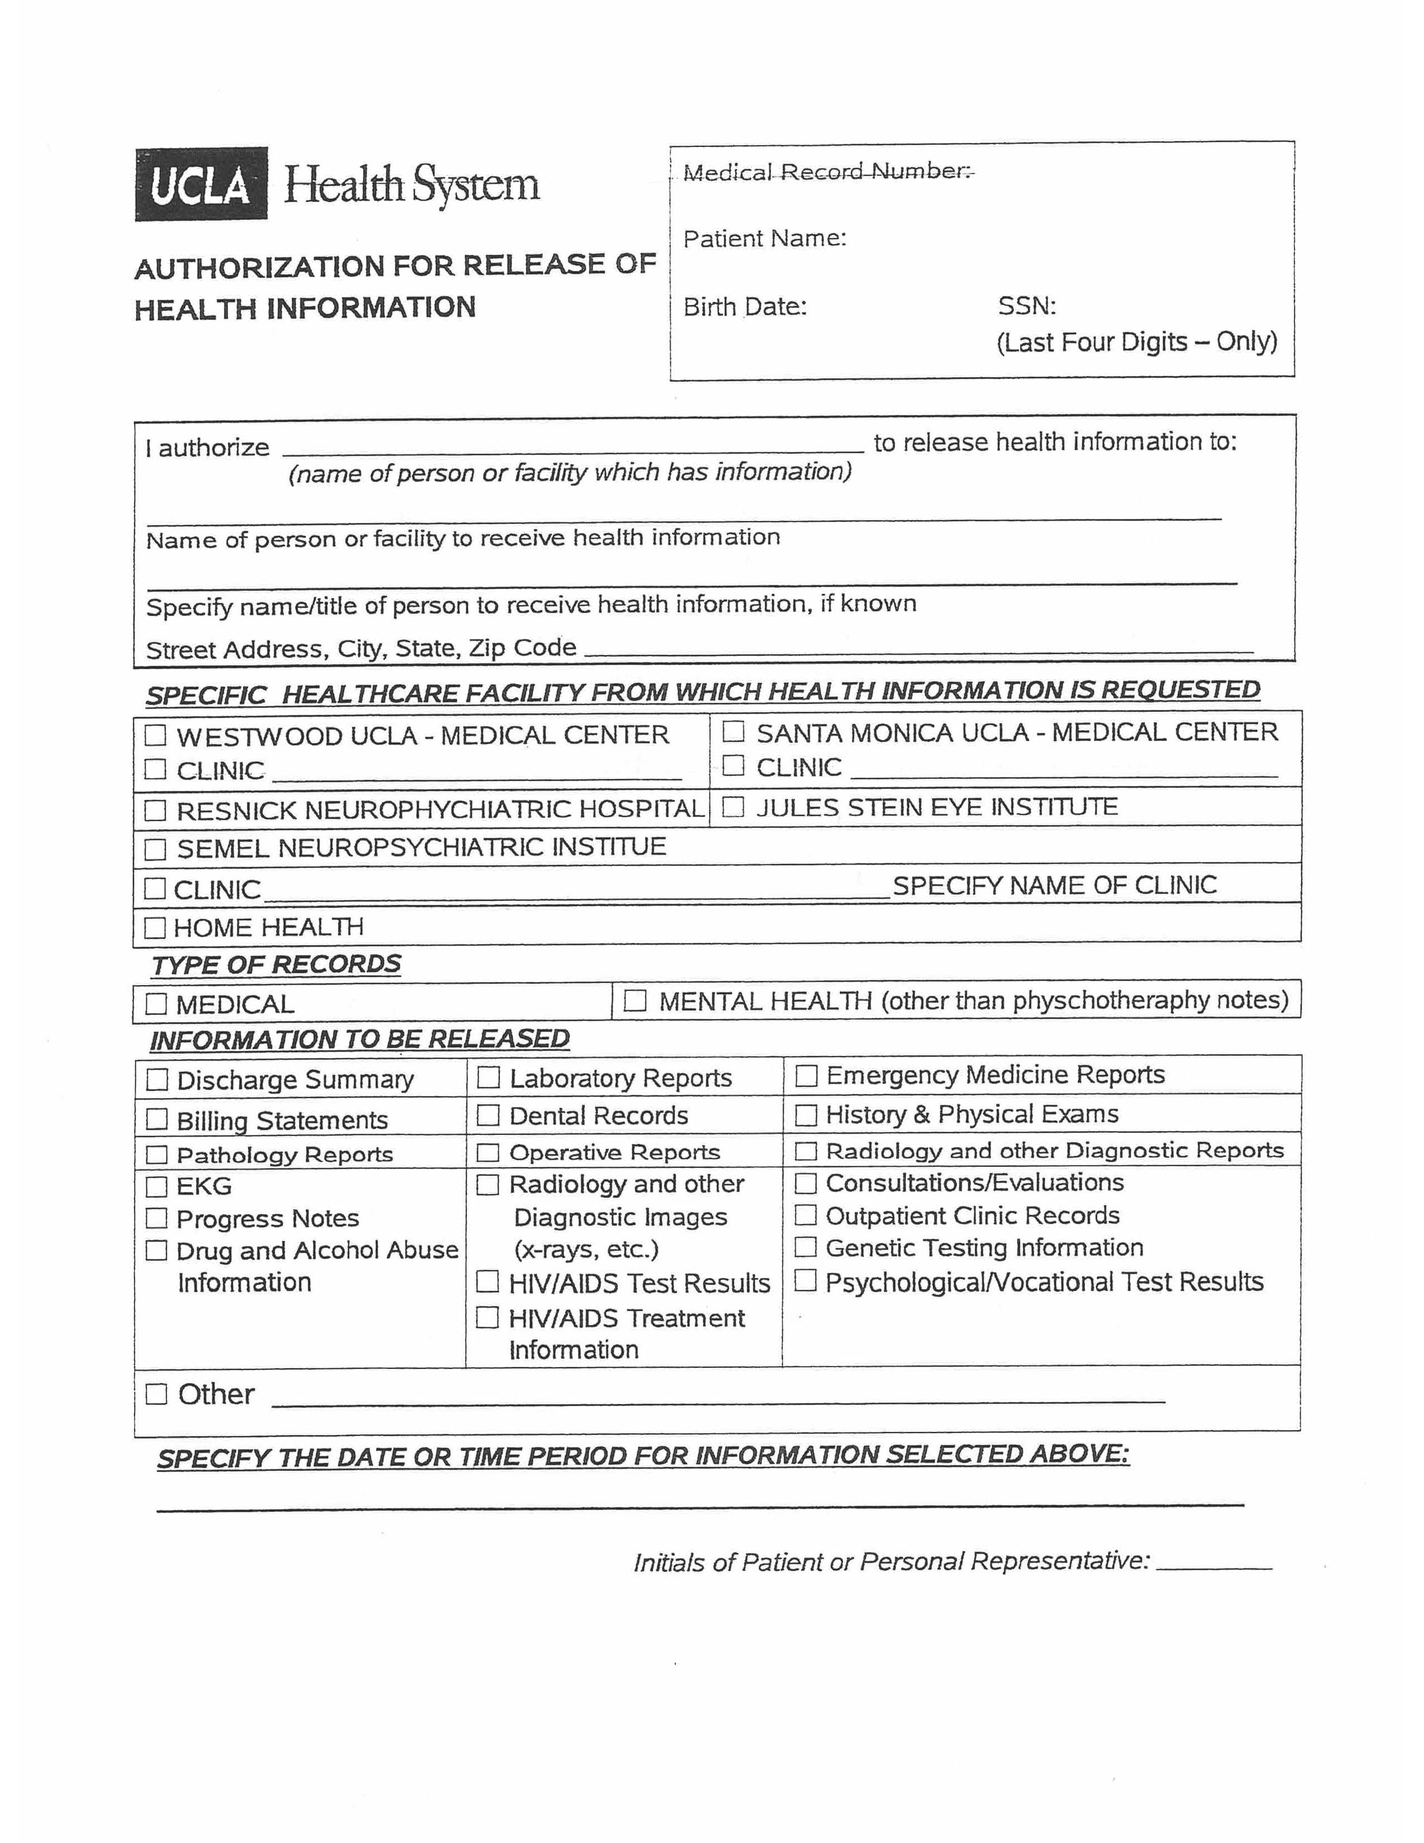
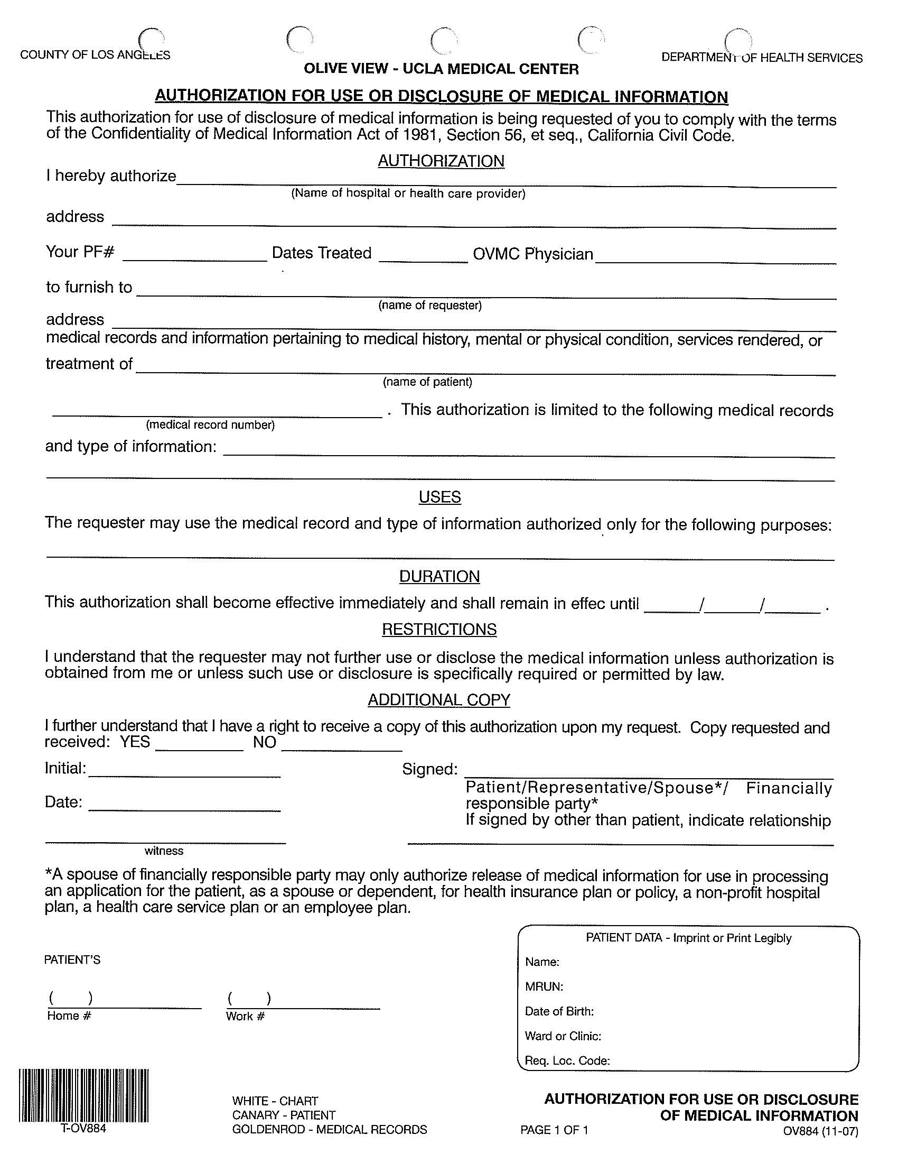
Medical record release of information form
If Mpox positive participant seeks care for Mpox and/or STI we will collect some information about the visit, admission, and any testing results, including outside facilities!
At enrollment, ask participant to sign and date, in case!
If participant does not test positive for Mpox, then can shred the form after 45 days.

Slide 22
Enrollment - Assigning
Project ID
BSMP | Baystate Medical Center
CSMP | Cedars-Sinai Medical Center
OVMP | Olive View-UCLA Medical Center
HCMP | Hennepin County Medical Center
JHMP | Johns Hopkins Hospital
TUMP | Temple University Hospital
OHMP | Oregon Health & Science University Hospital
RRMP | Ronald Reagan UCLA Medical Center
UIMP | University of Iowa
UMMP | University of Mississippi Medical Center
NMMP | University of New Mexico Hospital
MKMP | University of Missouri-Kansas City
VWMP | Valleywise Medical Center
Project ID is a unique alphanumeric number comprised of 4 letters (see table) and 3 numbers, starting with 001.

Slide 23
Data Collection Forms: Overview
Enrollment | 45-Day Follow-Up | 90-Day Follow-Up
Contact Information Form | Telephone Follow-up Form | Test results and Follow-up Form
Enrollment Form – All ages | Test results and Follow-up Form | If applicable, Healthcare Utilization Form
Enrollment Survey - self-administered for age 16+ years | If Mpox + → Healthcare Utilization Form
EMR Form 96 hrs
Everyone | Everyone | Mpox+ AND Symptoms

Slide 24
Enrollment
Enrollment
Contact Information Form
Enrollment Form – All Ages – 16 + Self Administered
EMR Form 96 hrs
Everyone

Slide 25
Enrollment
Enrollment
Contact Information Form
Enrollment Form – All Ages – 16 + Self Administered
EMR Form 96 hrs
Everyone

Slide 26
Enrollment
Enrollment
Contact Information Form
Enrollment Form – All Ages – 16 + Self Administered
EMR Form 96 hrs
Everyone
-Confidential, option to not answer questions
-Ipad, phone, or paper
-Step out of room but be nearby to assist

Slide 27
Enrollment
Enrollment
Contact Information Form
Enrollment Form – All Ages – 16 + Self Administered
EMR Form 96 hrs
Everyone

Slide 28
After Enrollment

Slide 29
45-Day Follow-Up
Enrollment | 45-Day Follow-Up
Contact Information Form | Telephone Follow-up Form
Enrollment Form – All Ages – 16 + Self Administered | Test results and Follow-up Form
Enrollment Form – 16 + Self Administered | If Mpox + → Healthcare Utilization Form
EMR Form 96 hrs
Everyone | Everyone

Slide 30
45-Day Follow-Up
45-Day Follow-Up
Telephone Follow-up Form
Test results and Follow-up Form
If Mpox + → Healthcare Utilization Form
Everyone

Slide 31
45-Day Follow-Up
45-Day Follow-Up
Telephone Follow-up Form
Test results and Follow-up Form
If Mpox + → Healthcare Utilization Form
Everyone

Slide 32
45-Day Follow-Up
45-Day Follow-Up
Telephone Follow-up Form
Test results and Follow-up Form
If Mpox + → Healthcare Utilization Form
Everyone

Slide 33
90-Day Follow-Up
Enrollment | 45-Day Follow-Up | 90-Day Follow-Up
Contact Information Form | Telephone Follow-up Form | Test results and Follow-up Form
Enrollment Form – All Ages – 16 + Self Administered | Test results and Follow-up Form | If applicable, Healthcare Utilization Form
Enrollment Form – 16 + Self Administered | If Mpox + → Healthcare Utilization Form
EMR Form 96 hrs
Everyone | Everyone | Mpox+ AND Symptoms

Slide 34
90-Day Follow-Up
90-Day Follow-Up
Test results and Follow-up Form
If applicable, Healthcare Utilization Form
Mpox+ AND Symptoms

Slide 35
90-Day Follow-Up
90-Day Follow-Up
Test results and Follow-up Form
If applicable, Healthcare Utilization Form
Mpox+ AND Symptoms

Slide 36
90-Day Follow-Up
90-Day Follow-Up
Test results and Follow-up Form
If applicable, Healthcare Utilization Form
Mpox+ AND Symptoms

Slide 37
Data Collection Forms: Overview
Enrollment | 45-Day Follow-Up | 90-Day Follow-Up
Contact Information Form | Telephone Follow-up Form | Test results and Follow-up Form
Enrollment Form – All Ages – 16 + Self Administered | Test results and Follow-up Form | If applicable, Healthcare Utilization Form
Enrollment Form – 16 + Self Administered | If Mpox + → Healthcare Utilization Form
EMR Form 96 hrs
Everyone | Everyone | Mpox+ AND Symptoms
Notes:
Go over clinician questions – clarify measurement and typical lesion.

Slide 38
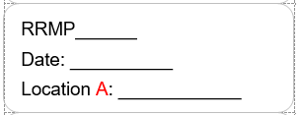
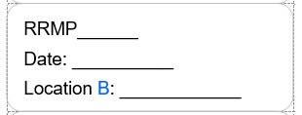
Photo of Lesions
Remove any personal identifiers (glasses, jewelry, etc.)
Pull aside clothing that distracts from lesion location
Avoid photo of tattoos unless they are part of lesion location
Attempt to take photo against a solid/neutral background
Use natural light if available
Take 2 photos of each lesion location that will be swabbed
  1st photo a distant shot to show the extent
  2nd photo a close-up to show details but include
  some normal nearby skin
  Include project ID label in the image
Store photos in secure location and upload to REDCap

Slide 39
Tips For Taking Rash Photos in the ED
Center the lesion in the middle of the photo frame
Tap on screen where lesion appears for mobile device
This sets focus and lighting.
Mobile phone cameras do not focus well when you get too close- step back and use cameras zoom feature.
iPhone – Zoom in with an outward pinch or put your finger on the 1x circle, and slide the “rotator” until you see a close view of the lesion/rash

Slide 40
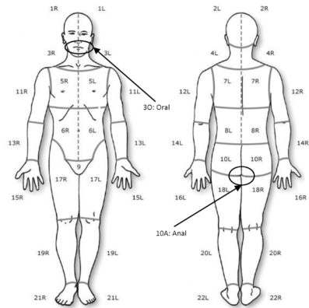
Which Lesions to Swab
If there are >2 lesion locations then provider should find the 2 locations where the lesions are most suspicious for mpox (i.e., vesicular, pustular, fluid filled)
If there are 2 different locations that have fluid filled lesions, then 1 swab should be taken for each of those locations. Therefore, a total 2 swabs taken
001
5/25/23
17L (R thigh)
001
5/25/23
7R (R back)

Slide 41
Which Lesions to Swab
If there is only 1 lesion location with fluid filled lesions, then 2 swabs should be taken from that 1 location
If there are no vesicular, pustular, or fluid filled lesions, then provider should
swab the lesion that is an ulcer
002
5/26/23
13L (L arm)
002
5/26/23
13L (L arm)

Slide 42
Preparing for Swab Collection
All recommended PPE should be worn
Use the research provided ESwabs
Vigorous swabbing of lesion gives higher chance of accurate results
Specimens that do not contain enough human DNA may lead to inconclusive PCR test results
Unroofing or aspiration of lesions or using sharp instruments is not necessary nor recommended due to risk of sharps injury
Do not clean lesion with ethanol or any other disinfectant prior to swabbing

Slide 43

Swab of Lesion Surface
Hold swab firmly and avoid touching the swab shaft at least 1” before the tip and the length of the swab shaft that will be submerged in the transport medium.
Swipe the swab back and forth on the lesion 2-3 times then rotate and repeat on the other side of the swab at least 2-3 times
Make sure to apply firm pressure which may result in discomfort but is necessary to obtain adequate DNA. Pressure must be firm enough so that the plastic shaft bends slightly
If lesion ruptures while swabbing, ensure swab collects lesion fluid
If skin material is visible on swab this is adequate collection, however skin material may not always be visible

Slide 44
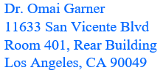
Swab Storage
Store swabs in -70°C or lower freezer if available, if not then store
in -20°C freezer
Ship every 2 weeks (the 15th and 30th/31st of every month);
No Saturday delivery
Review MOP for swab packaging and shipping with dry ice details
If Mpox result is positive and participant did not get a Mpox test as part of regular care then the DCC will notify the site of the positive result so that the participant can be informed
Notes:
Do we need to tell them that if they test positive, we will notify the participant if they don’t get standard care test?

Slide 45
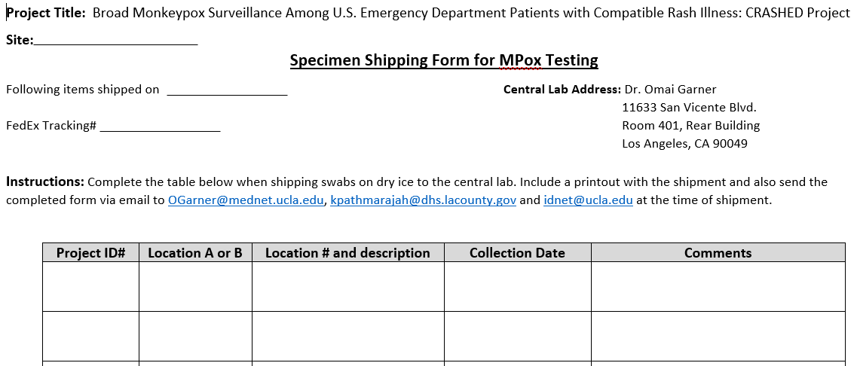
Shipping Form
Fill out Specimen Shipping Form, include a copy in the shipment and email a copy to OGarner@mednet.ucla.edu, kpathmarajah@dhs.lacounty.gov and idnet@ucla.edu
Olive View-UCLA Med Ctr
6/15/23
7648 6660 3245
OVMP001
A
17L (R thigh)
5/25/23
OVMP001
B
7R (R thigh)
5/25/23

Slide 46
CRASHED REDCap
How to get access
  If you already have access to UCLA REDCap, send an email to Anusha (idnet@ucla.edu) with list of staff to add to CRASHED project.
  If you do not have access to UCLA REDCap, send Lorenzo the following
    Signed REDCap access form (available on CRASHED website) and
    CITI human subjects training certificate
REDCap demo of the database
  Dual entry of non-survey forms
  Demo of how to administer Enrollment Survey

Slide 47
Audit of non-enrolled eligible cases
Objectives
  Determine our capture rate of eligible patients
  Identify issues with patient screening procedures
  Assess whether there is any selection bias in the patient population that agrees to participate in the project, e.g., are patients with certain demographics who are enrolled more or less likely to have Mpox infection compared to those who were not enrolled.
  ***Set this process up soon so you can complete your June audit early July.

Slide 48
Audit of non-enrolled eligible cases procedures
Generate a monthly report
Patients (> 3 months of age), AND has any of the following ICD 10 ED discharge diagnosis codes:
  B00-B09: Viral infections characterized by skin and mucous membrane lesions (includes Mpox: B04)
  L10-L14: Bullous disorders
  R21: Rash
  R22: Localized swelling, mass, or lump of skin
  R23.8: Vesicular Eruption, Blister, Papule, Pimple, Bleb
  N48-N49: Other disorders of Penis or Male Genital Organs
  N76: Other inflammation of vagina and vulva
  K60-K62: Fissure, Abscess, or other disease of anal and rectal regions
Remove the patients who do not meet inclusion criteria AND the patients that you enrolled from the list.
For each patient who met inclusion criteria who you did not enroll, fill out the Audit form.
Follow the instructions on the form to assign each patient an Audit ID.
Redcap study audit data entry module.

Slide 49
Site team communication
Weekly meetings
Group TEXT
Hospital Infection control

Slide 50
Next steps
Set your launch date
Test audit procedures
Test screening procedures
Questions?
idnet@ucla.edu
kpathmarajah@dhs.lacounty.gov
REDCap : lduvergne@mednet.ucla.edu
All project materials (including MOP) available at
https://www.emergencyidnet.org/current-research/crashed-project

