Slide 1

CRASHED project
June 2023 All site call
June 21, 2023
10am PT
PLEASE MUTE IF YOU ARE NOT SPEAKING!

Slide 2
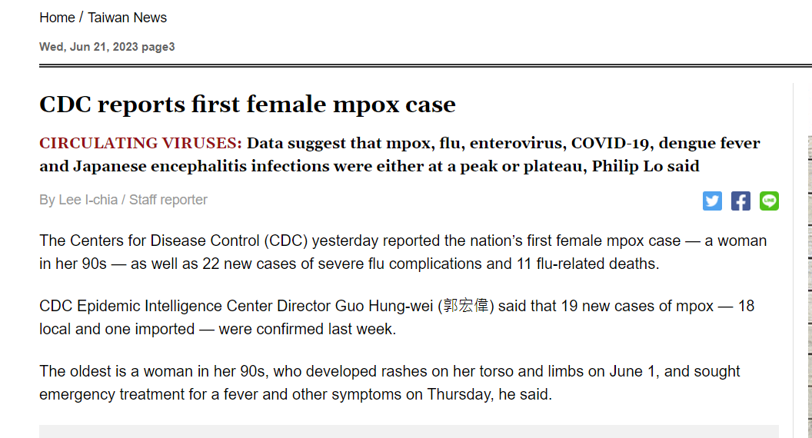
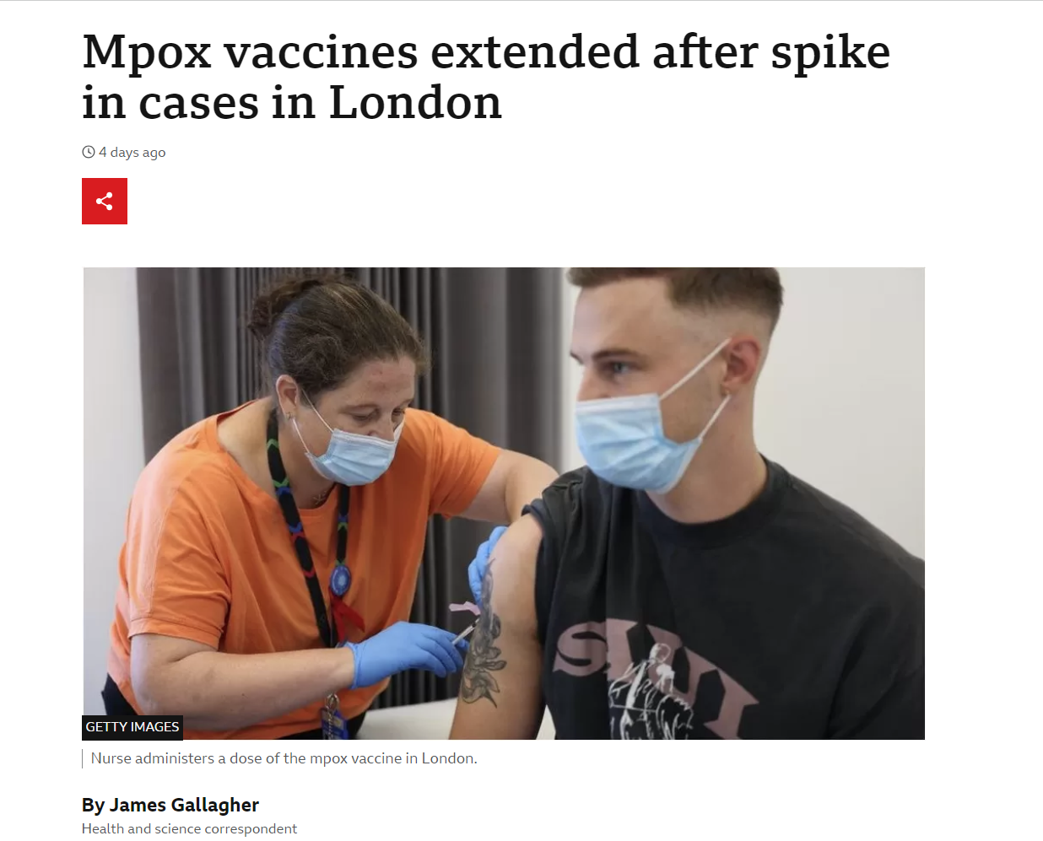
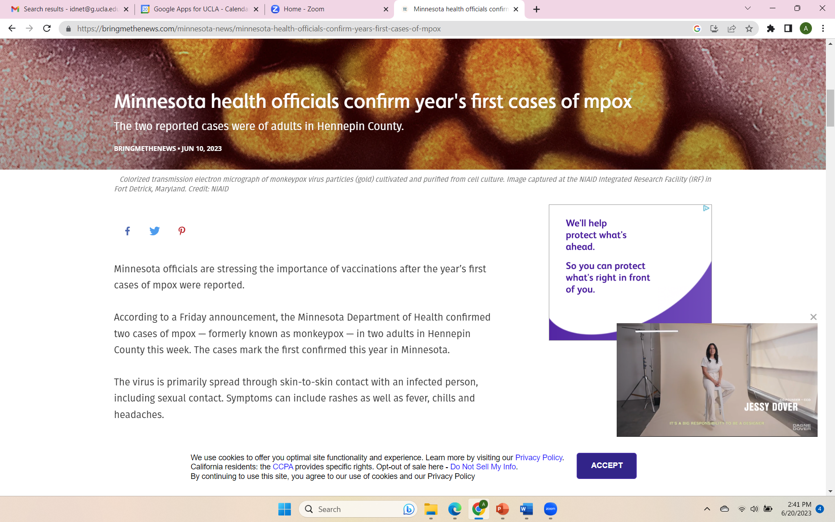

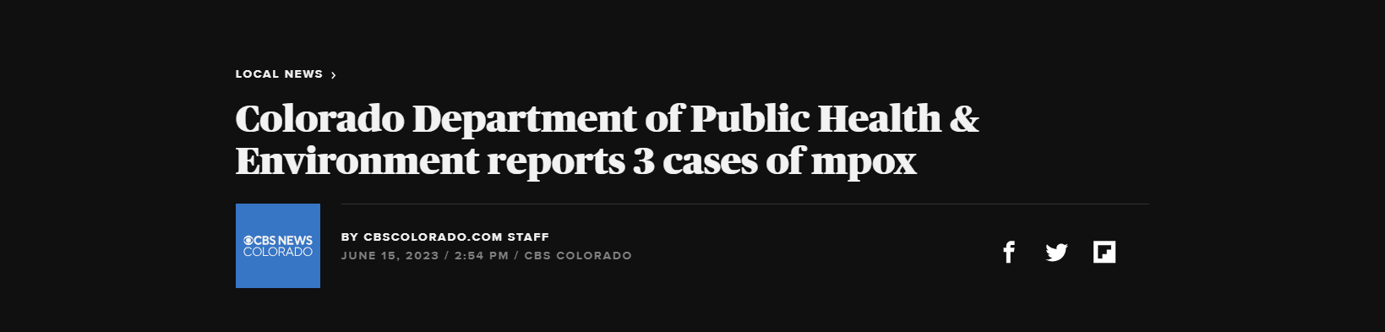

Slide 3

Agenda
Welcome
Project launch update
Which lesions to prioritize for swabbing
Clinician questions review
Image capture review
Data quality
Discussion and questions
REDCap update
Audit form revision

Slide 4
Enrollment and follow-up update
Site | Launch date | Enrolled | Follow-up
OV-UCLA | 4/15/2023 | 7 | 3
RR-UCLA | 5/1/2023 | 2 | 0
Hennepin | 6/5/2023 | 1 | 0
Valleywise | 6/5/2023 | 0 | 0
U Iowa | 6/5/2023 | 1 | 0
UNM | 6/6/2023 | 2 | 0
UH/UMKC | 6/7/2023 | 1 | 0
U Miss | 6/13/2023 | 2 | 0
Temple | 6/14/2023 | 0 | 0
Baystate | 6/15/2023 | 1 | 0
JHMI | 6/20/2023 | 0 | 0
Cedars Sinai | NOT LAUNCHED
OHSU | NOT LAUNCHED
TOTAL |  | 17 | 3

Slide 5
Guidance on how to decide what to swab
All participants should have two swabs collected!!
Notes:
Notes: Patients are only eligible for the study if they have one or more lesions that appears pustular, vesicular, ulcerative/erosive, or crusted. When collecting the first swab (primary lesion; Location A), choose the lesion that is the most suspicious for Mpox (i.e., nearest to the top of the table). All patients should have two swabs collected. According to CDC recommendations, lesions at different locations and of different stages should be swabbed if that is possible. Refer to Table 2 for guidance on how to identify the best lesions to swab.

Slide 6
Description of lesion number, location, and stage | Guidance
One lesion | Collect two swabs from same lesion
Two lesions | Collect one swab from each lesion (even if second lesion is less suspicious)
Two or more lesions, same body location, same stage | Collect swabs from any two different lesions
Two or more lesions, same body location, different stages | Collect one swab from most suspicious lesion; Collect one swab from a lesion of a different stage
Two or more lesions, different body location, same stage | Collect one swab from a lesion in one location; collect second swab from a lesion in the second location
Two or more lesions, different body location, different stages | Collect one swab of the most suspicious lesion in one location; Collect second swab of a lesion from a different location that is at a different stage
Guidance on how to decide what to swab (con)

Slide 7

Clinician questions guidance
Enrollment form Question #4 –
How many lesions are present?
We do not want a range, but an estimated number (NOT >10 or 5-7 lesions). Prompt them to give you one number value.
Enrollment form Question #7
“Estimate the approximate diameter of a typical lesion”
The word “typical” is included for cases when the patient has many lesions, so we can give the clinician some direction that they should provide a measurement of the most representative lesion of the stage of active infection. If there is only one lesion, then just enter the diameter of that one lesion and as above, we want a one number answer, NOT a range.
Enrollment form Question #8:
“Estimate the approximate diameter of the largest lesion”

Slide 8
Image capture of lesion
Obtain two pictures of each lesion. One close up and one farther away (to see the span of the rash).
If there is only one lesion, take two pictures, i.e., one close up and one farther away.
If there is more than one lesion, take two pictures of one lesion location and two pictures of the 2nd lesion location. These two locations will correspond with the lesions that you swab for the project.
For each participant there will be either 2 or 4 images captured.
Make sure you have good lighting and positioning, e.g., if lesion is in mouth, try to shine a light in the mouth while taking picture.

Slide 9
Data quality – Section 9.2 of MOP
All paper forms should be reviewed within 24-48 hours of completion
Data collected on the paper forms should be entered into the REDCap database within 3-4 days of collection.
DUAL ENTRY - To identify and minimize data entry errors and streamline the data cleaning process
At least once a week, a site coordinator should be appointed to review all the forms entered into REDCap that week, double-check the data abstracted on the forms and entered into the REDCap, and then after their review, mark the forms as “Complete.”
The site PI or manager must review the first 3 participant enrollment forms in the first month of the project, and 6 weeks after, the 3 participant’s follow-up forms.

Slide 10
REDCap and Form updates
Need Access? Email Lorenzo!
Enrollment survey now available in Spanish
Changes to telephone follow-up form to simplify language (working on Spanish version)
Data entry – if entering an outlier, include a note in comments
Changes to audit form – add patients who had Mpox test ordered in ED.
45 day Follow-up survey (to email or text) still under construction

Slide 11
Audit form - revision
  Generate a report of patients ≥ 3 months old with at least one of the ICD 10 codes listed on audit form) OR an Mpox test ordered in ED
  Don’t include in audit
  - If no mention of rash in EMR and no Mpox test ordered
  - If rash is mentioned but not described and no Mpox test ordered
  Include in audit
  - mention of rash that fits inclusion criteria with words like vesicular, pustular, erosive, ulcerated/ulcer, blister, pimple, herpetic, herpes-like
  If you are unsure – ask your site PI or email Anusha or Kavitha

Slide 12
Olive View-UCLA Site April Audit results
  120 patients,
  3 had Mpox test ordered

Slide 13
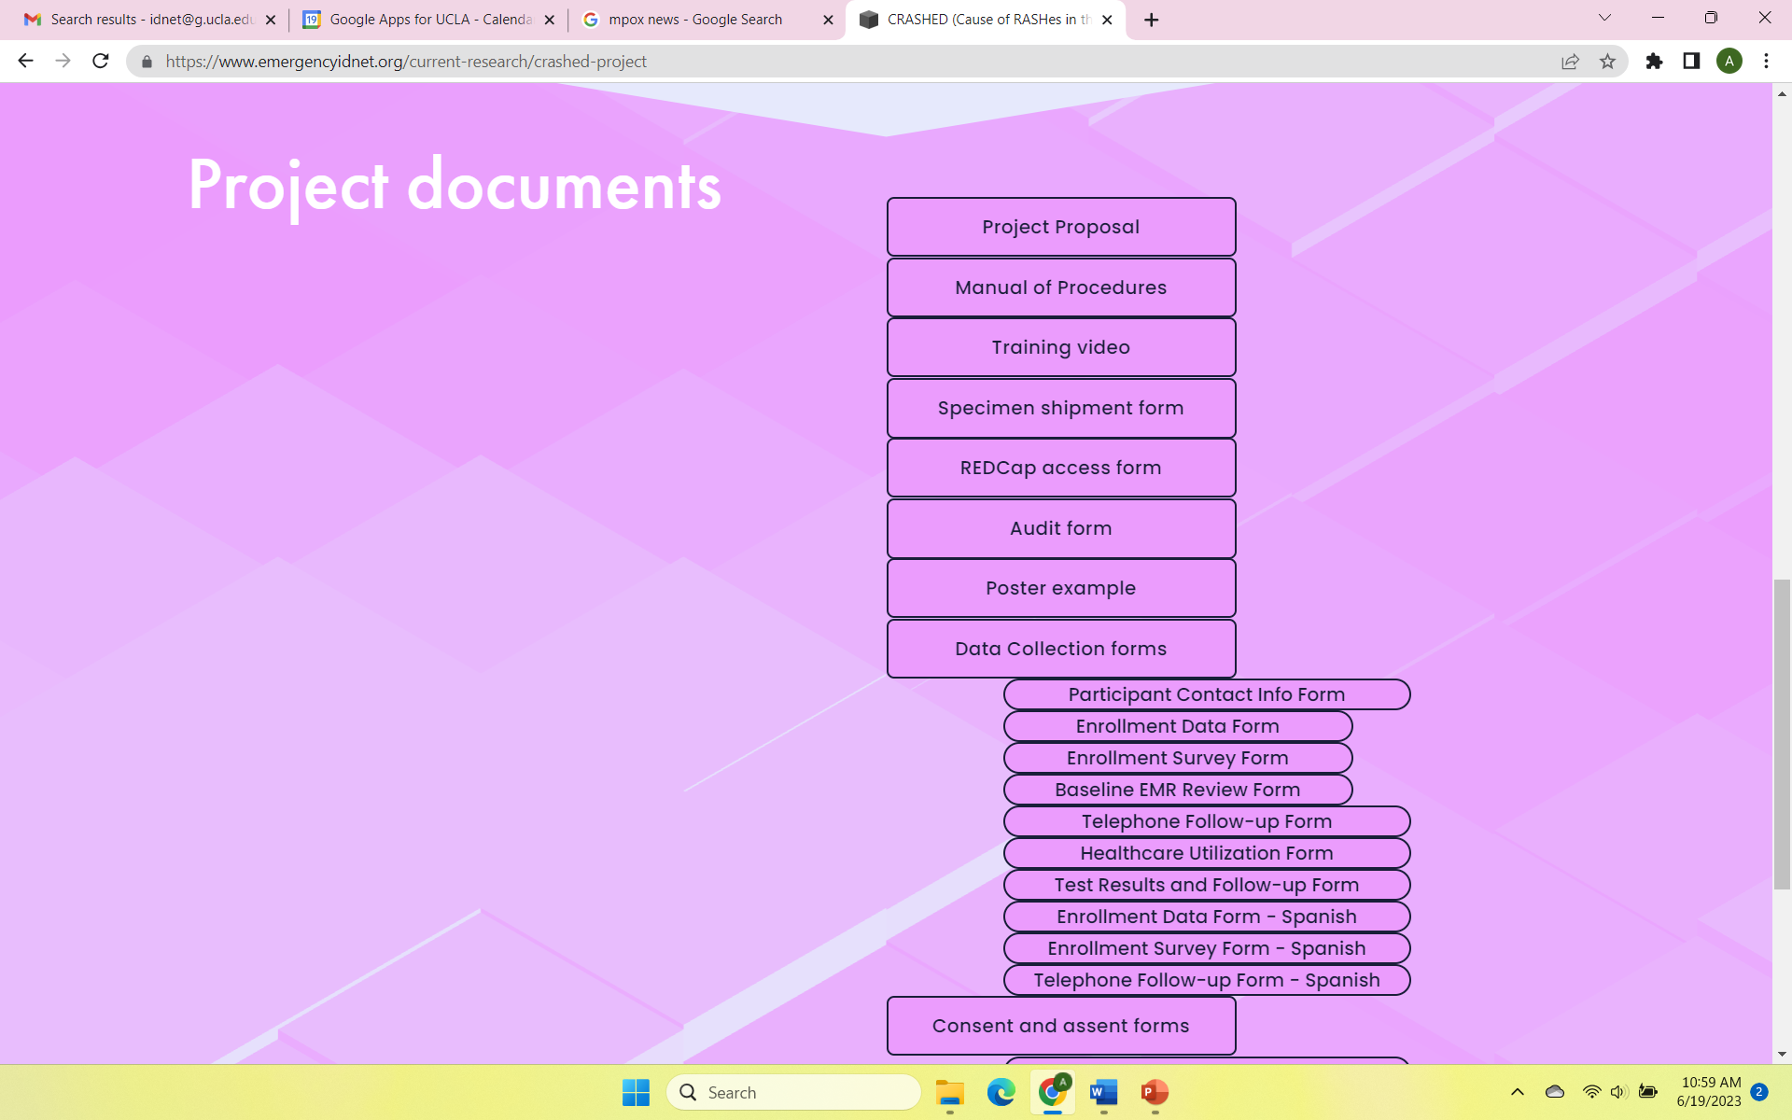
CRASHED Project Website

Slide 14
Site discussion/feedback
1. Provide general update
2. Describe site team communication
3. Barriers/issues?
Site | Launch date | Enrolled | Follow-up
OV-UCLA | 4/15/2023 | 7 | 3
RR-UCLA | 5/1/2023 | 2 | 0
Hennepin | 6/5/2023 | 1 | 0
Valleywise | 6/5/2023 | 0 | 0
U Iowa | 6/5/2023 | 1 | 0
UNM | 6/6/2023 | 2 | 0
UH/UMKC | 6/7/2023 | 1 | 0
U Miss | 6/13/2023 | 2 | 0
Temple | 6/14/2023 | 0 | 0
Baystate | 6/15/2023 | 1 | 0
JHMI | 6/20/2023 | 0 | 0
Cedars Sinai | NOT LAUNCHED
OHSU | NOT LAUNCHED

Slide 15
Questions?
Questions about procedures – idnet@ucla.edu, kpathmarajah@dhs.lacounty.gov
Questions about REDCap access and entry – lduvergne@mednet.ucla.edu
AK going on vacation 6/27-7/6

